Slide 1
Misinformation on Twitter
Group 2
Alex Day
Megan Fowler
Xiaohong Zhang

Slide 2
Story
Twitter has been a hotbed of bot account and malicious misinformation campaigns
Information spread on twitter relies on two aspects
Time
Movement through communities
These two aspects differ wildly when comparing falsehoods and non-rumors
This difference can be used to visually classify the tweet networks
Notes:
Alex

Slide 3

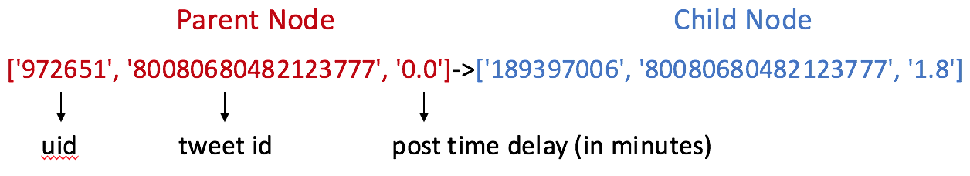
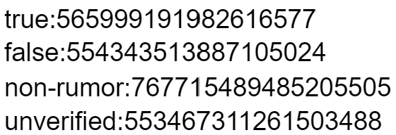
Network Dataset ^{[1]}
Contains 1,490 source tweets (acts as parent node)
Each retweet is a child
Each network was contained in its own text file
Contains 3 data fields
Labels for source tweets were stored in seperate text file.
label
tweet id
Notes:
Megan

Slide 4
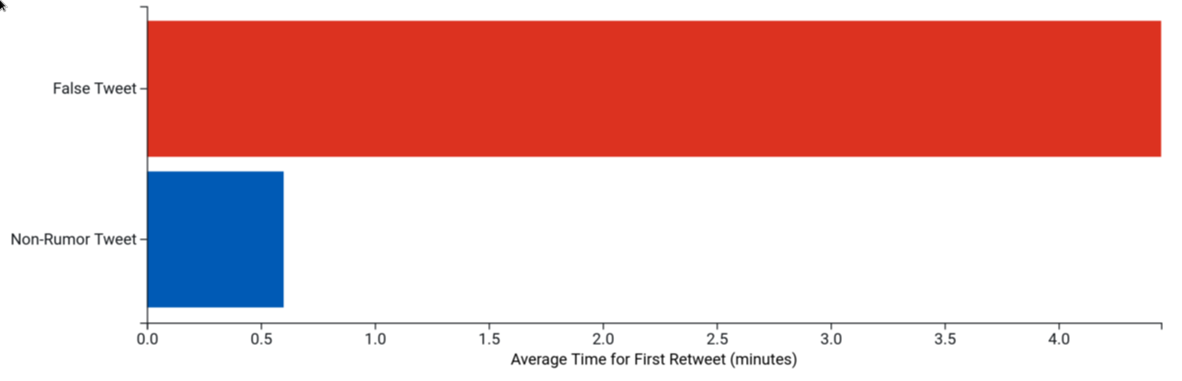
Showcase
Bar chart with the average first retweet delay times plotted
Average “time-till-discovery” is higher for False tweets
Notes:
Alex

Slide 5
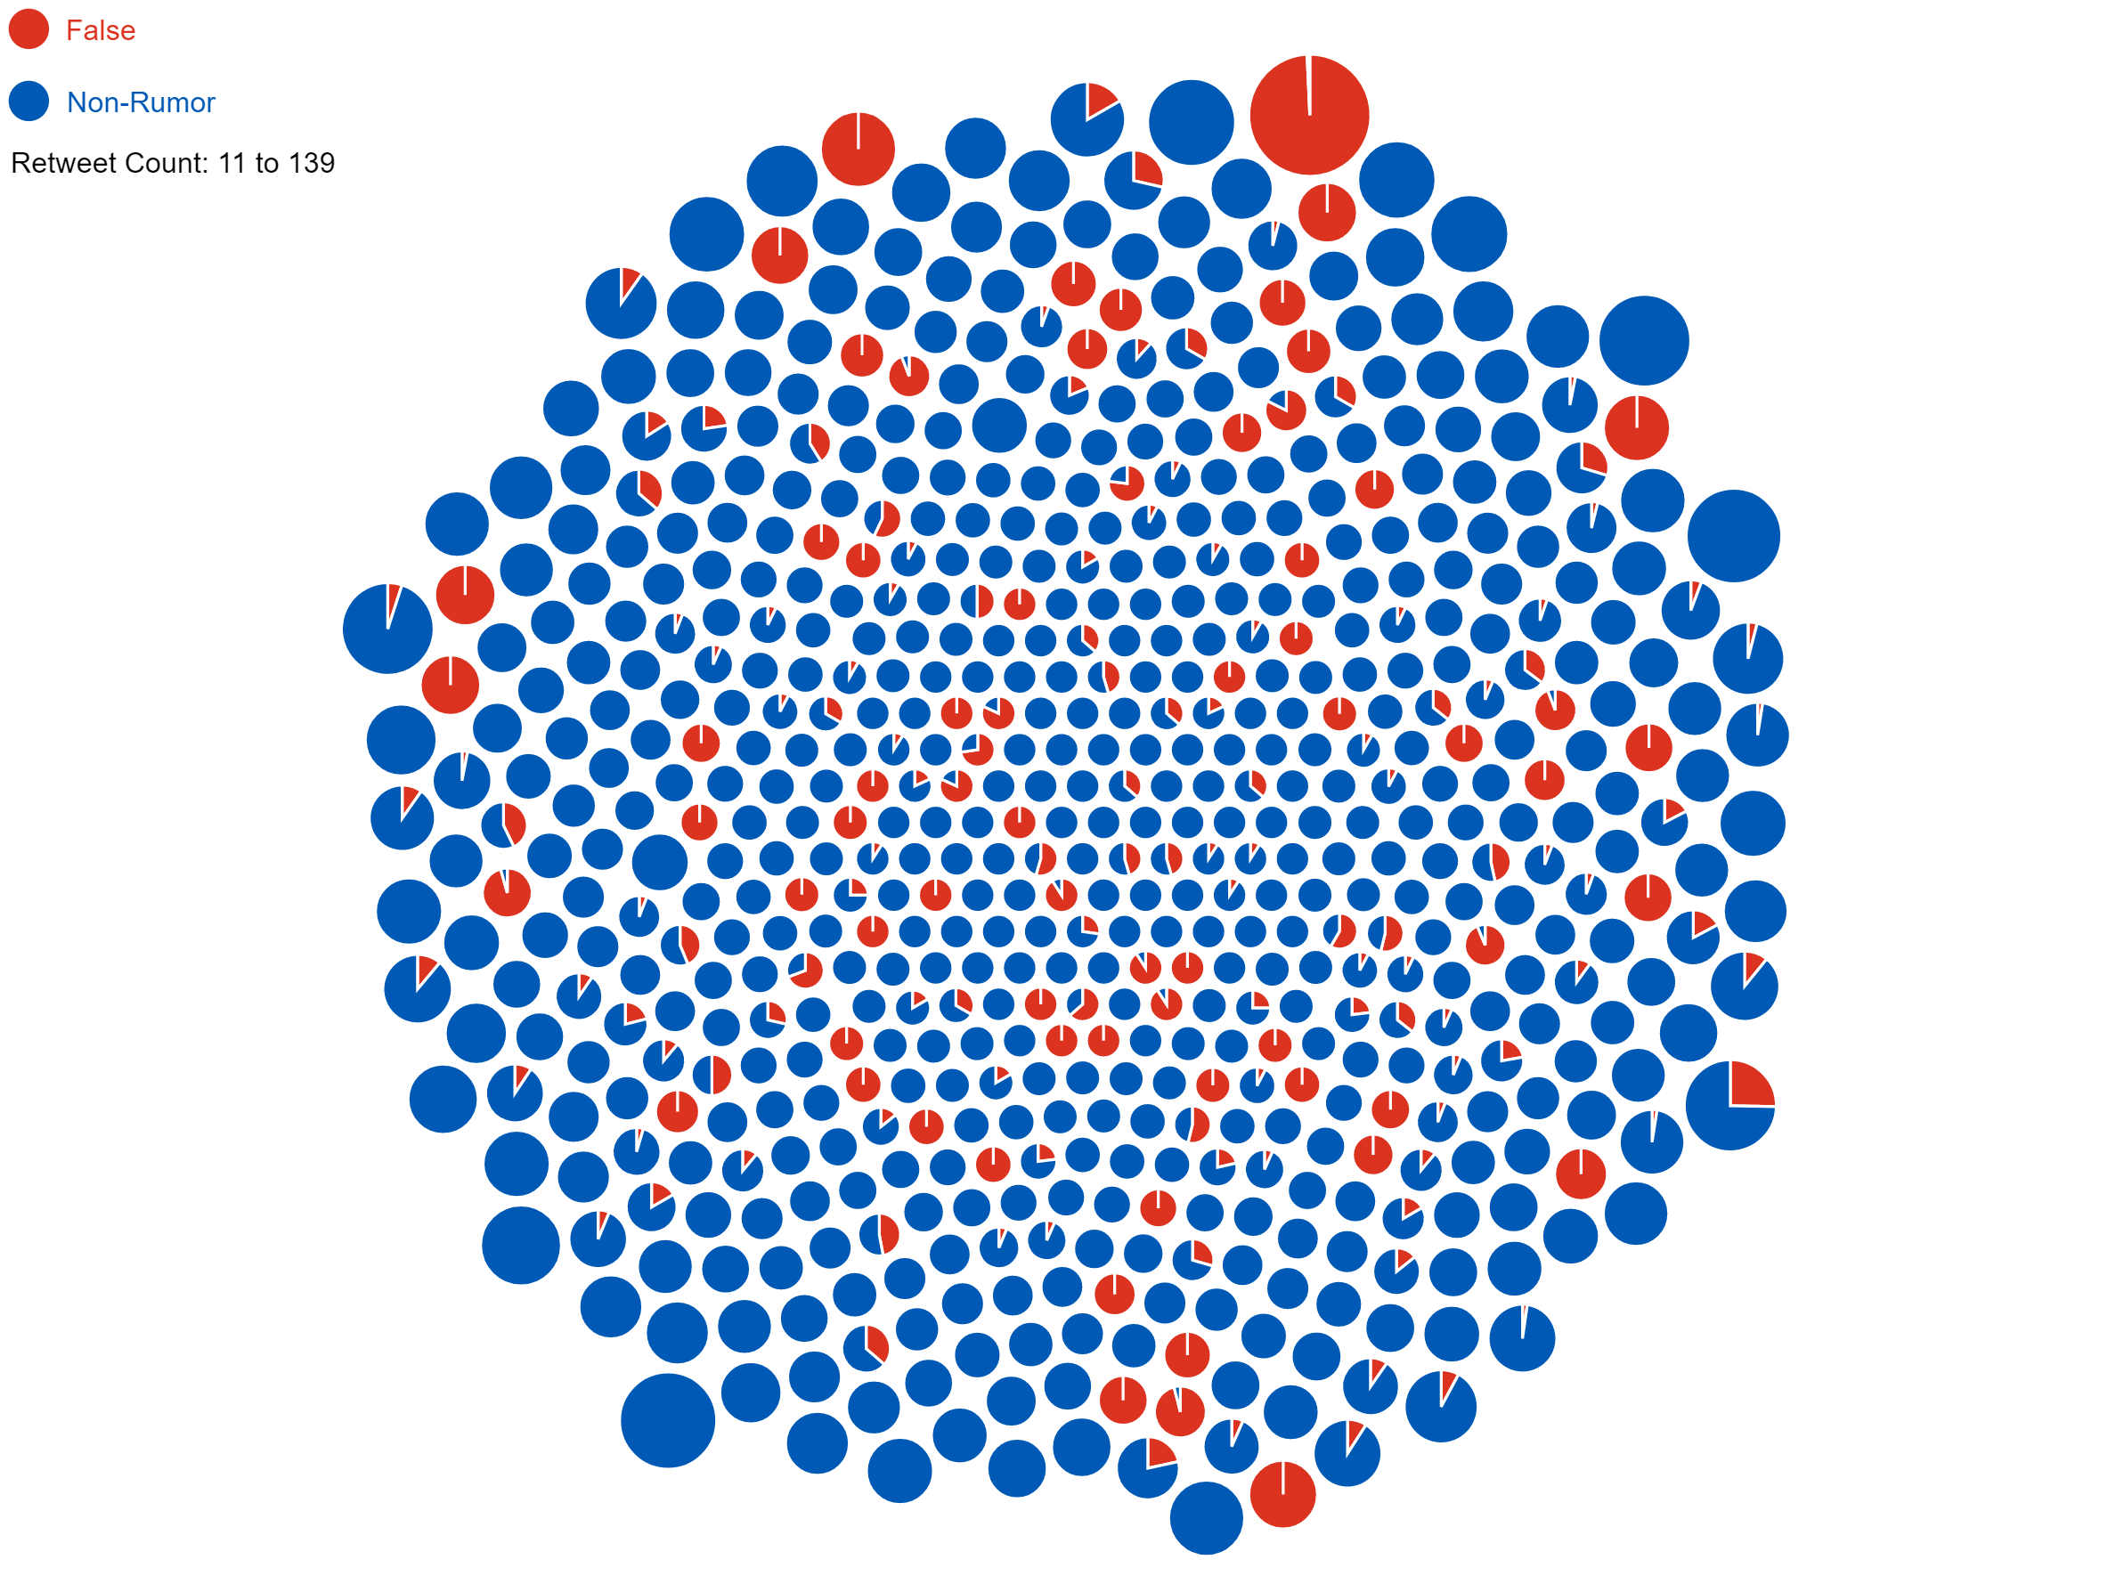
Showcase
Each pie chart is an individual user
types of tweets shared
amount of tweets shared
Tweets labeled as non-rumor have many users who retweet, which may explain the large disparity between the average first retweet time.
Notes:
Megan

Slide 6
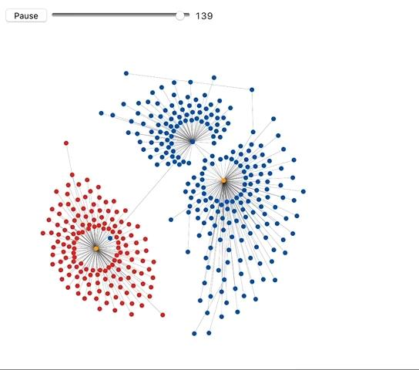
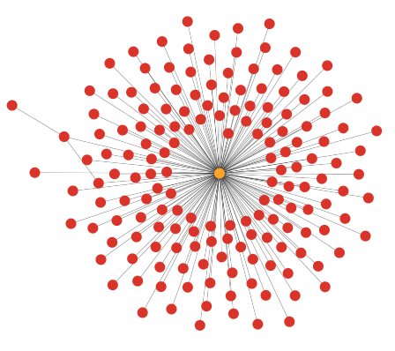
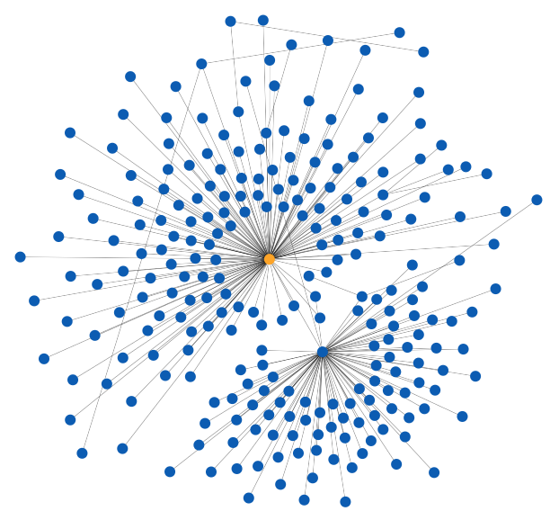
Showcase
False and Non-Rumor tweets have different spreading patterns
False
Non-Rumor
Notes:
Xiaohong

Slide 7
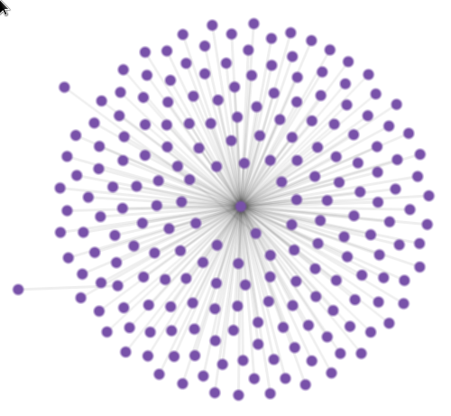
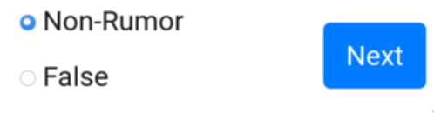
Showcase - Quiz
Tweets can be visually classified using the graph visualization
5 question quiz in visual network classification
Notes:
Xiaohong

Slide 8
Thanks!
Questions?

Slide 9
References
[1] Liu, Xiaomo, et al. "Real-time rumor debunking on twitter." Proceedings of the 24th ACM International on Conference on Information and Knowledge Management. 2015.
[2] Ma, Jing, et al. "Detecting rumors from microblogs with recurrent neural networks." 25th International Joint Conference on Artificial Intelligence, IJCAI 2016. International Joint Conferences on Artificial Intelligence, 2016.
[3] Ma, Jing, Wei Gao, and Kam-Fai Wong. "Detect rumors in microblog posts using propagation structure via kernel learning." Association for Computational Linguistics, 2017.

